Slide 1


MAS Summary
Context
Goal
Data
MAS is an end-to-end scalable platform that hosts plant data to support and enable users (shopfloor, data scientist) to extract, perform develop advance analytics and algorithms for enriched insights along with user feedback
Platform can save a significant amount of time as data access, preparation and analysis takes up. Offerings such as ADE create positive impact on FPY, throughput and OEE and costs reduction in plants through
Process curves
Qualitty
Impact
ADE mentioned in world economic forum as key factor for OEE improvement.
Process curve is a strategic topic for BIS
Next year activity
Current year activity
Transport/ Stock Mgmt
User Interface for Custom Extract Ordering
PCA / ADE activities
POC for staubli-robots
Productionize spinner, tightening
Multivariate (process curve)
Multivariate (quality)
Challenges / lessons learned
Onboard New Data sources (Packaging, QDAS)
Cloud Migration + CI/CD for PS
Low latency pivot
Process Curve 2.5, 3.0+
3 new use cases (spinner, staubli-robots, tightening)
IN team demonstrated strong execution focus
IN team: Support --> colead --> own topic
Substantial footprint of IN team for MAS
ADE ownership since 2023
PCA ownership from 2024
Execute on more pilots,
Continue to strengthen customer channels
Truly make MAS a global tool (currently PS driven)
Notes:
QDAS : tests that get done on parts selected randomly and where results are shared with the customer.
The tests very intense/ detailed

Slide 2

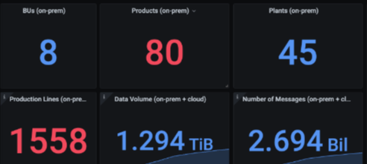
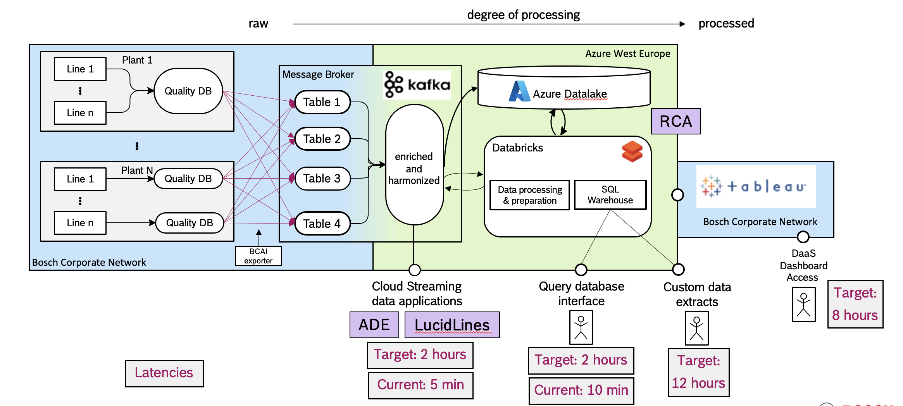
MAS – DaaS and DevOps
Context
Goal
Data
A collection of applications providing the data layer for all MAS use cases.
A data warehouse that developers/end users can leverage for further analysis, dashboards, AI applications.
A pipeline from the raw data sources that transforms the data as required by end users/applications. Processes include:
Standardization of schema
Denormalization of raw tables
Enrichment with user-provided metadata
Harmonization of data sources
Automation of processes
Quality Parameters
MMPD
PDA/MDA
Impact
Current year activity
Onboard New Data sources
Packaging
QDAS
Transport/Stock Management
Cloud Migration
Establish CI/CD for all components
User Interface for Custom Extract Ordering
Past year activity
Cloud Readiness
Onboarding PDA/MDA
Integrate IPN Management View Data
Notes:
Currently Anuraj is overseeing this activity from IN ~ 25%
Vivek/ Shankar

Slide 3

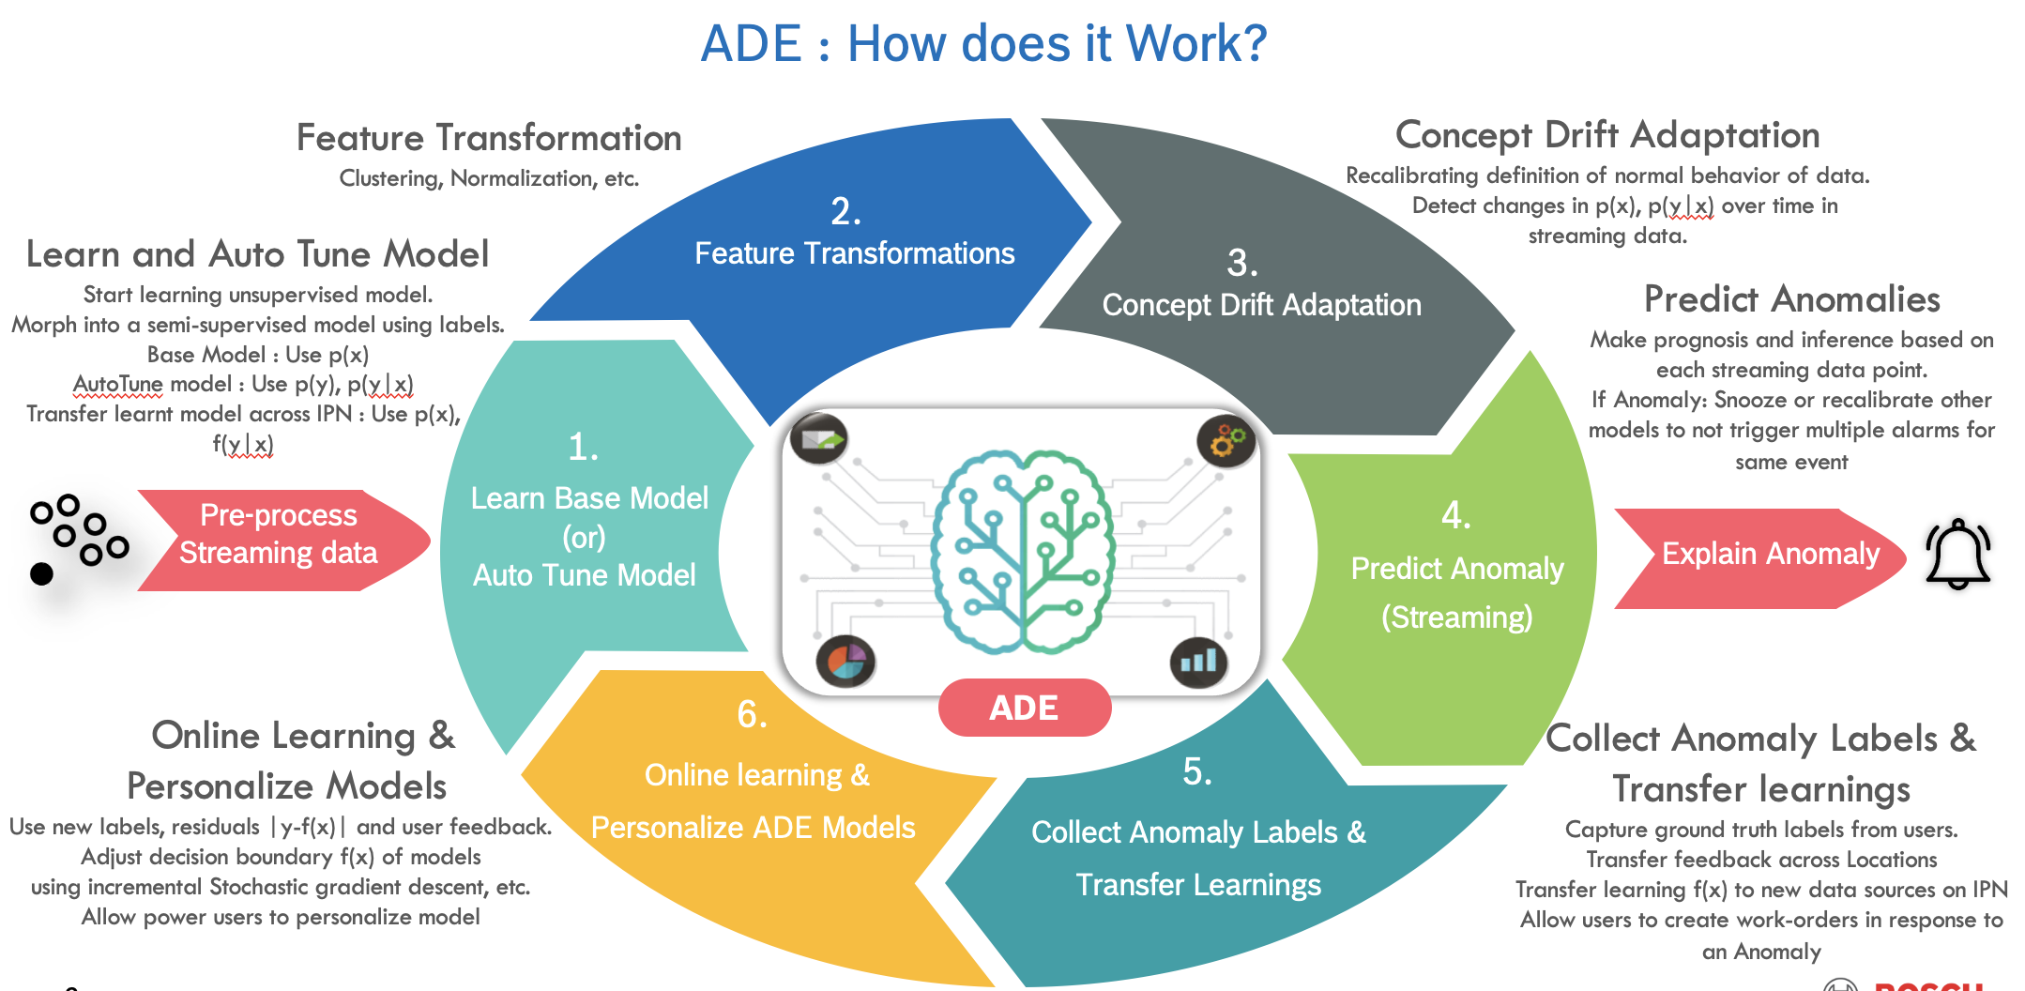

MAS – ADE (Anomaly Detection Engine)
Context
Goals and Scope
Data
Notify users in real-time of relevant anomalies observed in a monitored data stream.
Expert-defined anomaly rules are not required to detect anomalies
Labeled data is not required to monitored anomalies
Adapts to changes in the distribution of the data
User feedback is used in real time to refine the decision boundary
ADE creates positive impact on FPY, throughput and OEE and costs reduction in plants through
Reduction of unplanned downtimes, recalibration and rework.
Prevention of production problems and reduction of reaction
times to solve them once they occur.
Reduction of scrap and failure rates.
Streaming Data
Quality Parameters
Process Curves
Impact
Current year activity
20 IPN’s , 15 plants
Integrated as part of standard deviation management work process in many plants (BuP1)
Cloud Migration
ADE on Process Curve/ Time Series Data
Benchmarking of Process curve results with Cinderella and Spinner expert defined anomalies rules
ADE on demand (in progress)
Multivariate ADE (to be started)
Anomaly Explainability (part of cont. Improvement)
ADE based Failure Prediction. (in progress)
Continuous Bug Fixing and support tickets from Customer
Past year activity
Scaling Up ADE to all MAS Plants.
ADE IdM Integration for access control
Advanced Feature Engineering settings
Notification Forwarding, work order creation in Nexeed IAS, PPN
Application Stability.
Notes:
Process curve: 2.5, 3.0 planned (univariate algo deployed for cp4 data) + visualization
POC's:
spinner (benchmarking with cindrella and tested with offline csv from bamberg: BaP ) - approved for productionization (all Bamberg spinner). Impact not clear yey
staubli robots (scope to be defined, awaiting)
Tightening (NhP) -- POC completed, included part of BIS leads (follow up with AE re. Contracts via Sven WIP)
ADE on demand (2024): Apply ADE on user data (in progress)
Failure prediction (2024) : built a model on quality data to see if we can predict NoK (part failure in subsequent stations). Presented and more validation (presented to Azeem + Berna)
Interruption prediction from RHI (2024)
Multivariate (2024)

Slide 4
MAS – DaaS and DevOps
Context
Goal
Data
A collection of applications providing the data layer for all MAS use cases.
A data warehouse that developers/end users can leverage for further analysis, dashboards, AI applications.
A pipeline from the raw data sources that transforms the data as required by end users/applications. Processes include:
Standardization of schema
Denormalization of raw tables
Enrichment with user-provided metadata
Harmonization of data sources
Automation of processes
Quality Parameters
MMPD
PDA/MDA
Impact
Current year activity
Onboard New Data sources
Packaging
QDAS
Transport/Stock Management
Cloud Migration
Establish CI/CD for all components
User Interface for Custom Extract Ordering
Past year activity
Cloud Readiness
Onboarding PDA/MDA
Integrate IPN Management View Data

Slide 5
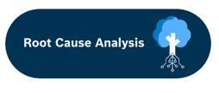
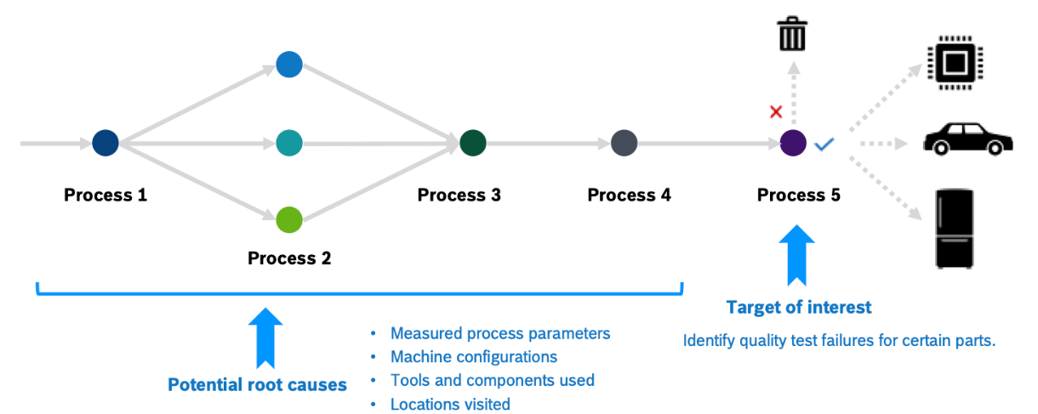
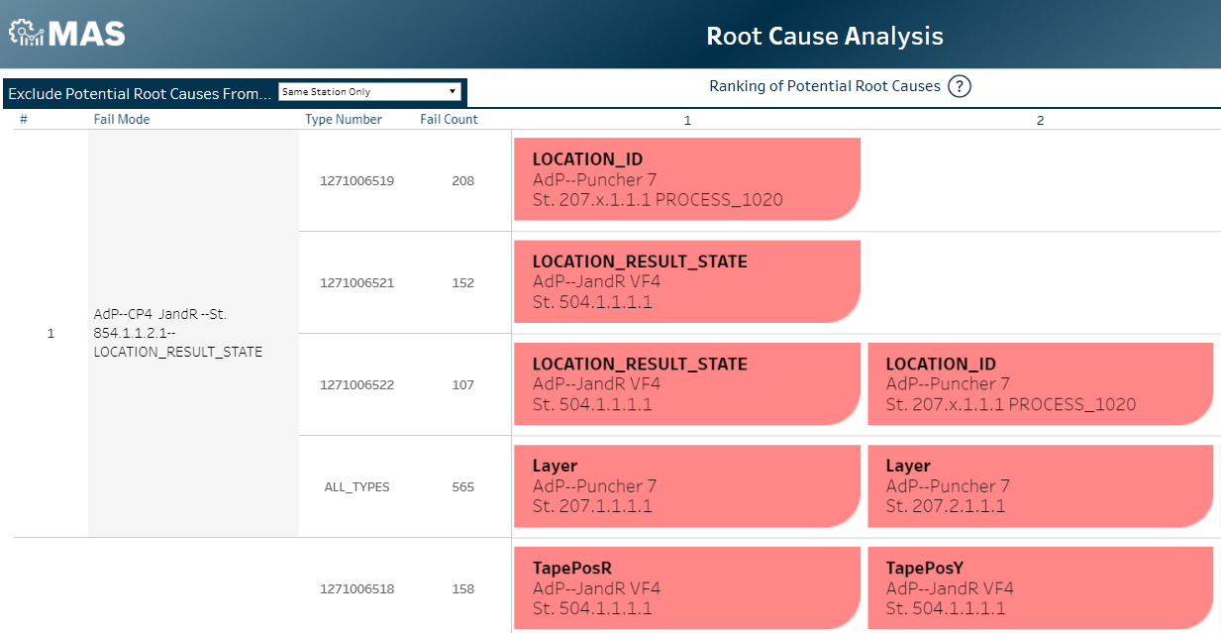
MAS – RCA (Root Cause Analysis)
Context
Goals
Data
Identifying why parts are failing in assembly lines
Using explainable machine learning and statistics
In a scalable manner
To support process engineers and data scientists by facilitating data exploration and analysis for troubleshooting manufacturing problems
Quality data
Graph data (process graphs)
Current year activities
Impact
Refactoring code
Improved explainability definitions for univariate analysis
Feature reduction type-II (cont-cont) and type-III (cont-cat)
Developing and deploying code for multivariate modelling
New global and local explainability definitions for better ranking potential root causes and for allowing users to understand why a particular part fails
2.5M+ parts
13k+ measurements (features)
2.8k+ failure modes (targets)
Past year activities
POCs for explainable multivariate modelling
Feature reduction type-I (cat-cat)
Improved logging
Operations-related issues

Slide 6
MAS – ADE (Anomaly Detection Engine)
Context
Goals and Scope
Data
Notify users in real-time of relevant anomalies observed in a monitored data stream.
Expert-defined anomaly rules are not required to detect anomalies
Labeled data is not required to monitored anomalies
Adapts to changes in the distribution of the data
User feedback is used in real time to refine the decision boundary
ADE creates positive impact on FPY, throughput and OEE and costs reduction in plants through
Reduction of unplanned downtimes, recalibration and rework.
Prevention of production problems and reduction of reaction
times to solve them once they occur.
Reduction of scrap and failure rates.
Streaming Data
Quality Parameters
Process Curves
Impact
Current year activity
20 IPN’s , 15 plants
Integrated as part of standard deviation management work process in many plants (BuP1)
Cloud Migration
ADE on Process Curve/ Time Series Data.
ADE on demand.
Multivariate ADE
Anomaly explainability
ADE based Failure Prediction.
Past year activity
Scaling Up ADE to all MAS Plants.
ADE IdM Integration for access control
Advanced Feature Engineering settings
Notification Forwarding, work order creation in Nexeed IAS, PPN
Application Stability.

Slide 7


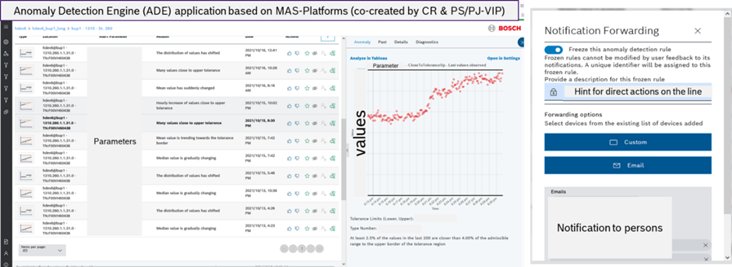
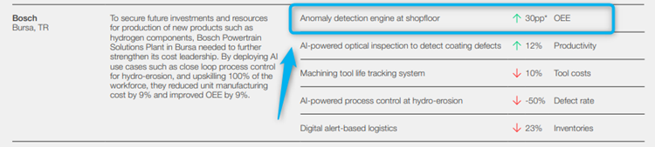

ADE - Anomaly Detection Engine | Use Case @ Bursa Plant
ADE notifies, explains and helps users explore the cause for an anomaly
By deploying Anomaly Detection Engine (ADE), BuP1 was able to improve Overall Equipment Effectiveness (OEE) by 30%.
The World Economic Forum evaluates leading manufacturers across the world in search of the most advanced sites.
Bosch's Bursa Plant (BuP1) is recognized as part of the World Economic Forum Global Lighthouse Network for double digit improvements in financial, operational and sustainability metrics are their markers of success
Picture of ADE from BuP1-HDEV6
"Based on this success, we can really say Bursa is on the right path to create value and increase data utilization by using Anomaly Detection Engine (ADE) and further solutions." - Azeem Lodhi

Slide 8













MAS Applications Suite – Many More to Come…
Expert Engine
Knowledge Engine
Recommendation Engine
Optimizer Engine
ADE
Prediction Engine
Prescriptive
Recommend an action
to influence outcomes
Pattern Mining
Engine
Predictive
Forecast the type of event likely to happen
RCA
Analytics
Engine
DaaS
ADE
LucidLines
Diagnostic
Explain why an event happened
Descriptive
Explain what has happened so far
2023 Release
2024-2025 Release
Notes:
Diagnostic AI
Application purpose slide
Application characteristics
Analytics – Descriptive -> Diagnostic (PM, ) -> Predictive -> Prescriptive
Generative – What can be done
DaaS -> Des
LucidLines -> Desc
ADE -> Desc
AE -> Desc
RCA -> Diag
PE -> Pred
KME -> Pres
PME -> Pres
QE ->Pres
RE -> Pres
Optimizer -> Pres
Notifies users in real-time of relevant anomalies observed in data monitored. The engine constantly learns and adapts to changes in the monitored data and also incorporates user feedback to customize alerts

Slide 9





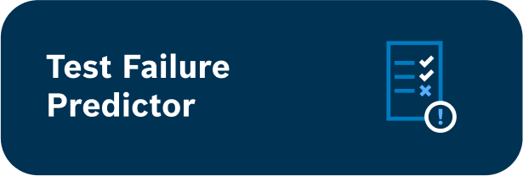















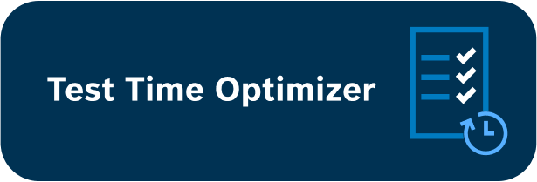

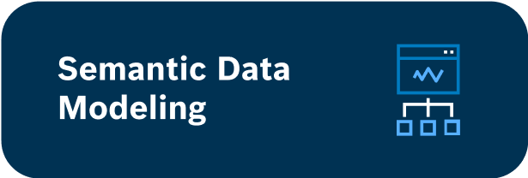
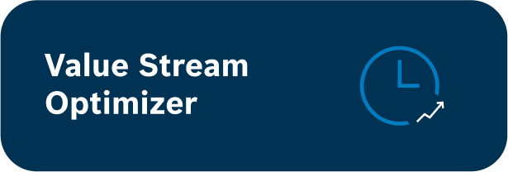


MAS Applications Suite – Many More to Come…
Prediction Engine
Knowledge Engine
Pattern Mining Engine
Analytics
Engine
Expert Engine
Recommendation Engine
Optimizer Engine
2023 Release
2024-2025 Release
Notes:
Notifies users in real-time of relevant anomalies observed in data monitored. The engine constantly learns and adapts to changes in the monitored data and also incorporates user feedback to customize alerts

Slide 10
Thank You

Slide 11


Development
MAS provide users easy access to manufacturing data at scale and a comprehensive suite of analytics solutions to automatically detect, diagnose, predict, and prescribe solutions for manufacturing related inefficiencies.
Data Warehouse
Data Lakehouse with BYOD
A highly automated 'Data Warehouse' solution for structured numeric manufacturing data to enable self-exploration and self-analysis
A highly automated 'Generalized Data Lakehouse' solution for structured and unstructured Manufacturing data (Numeric, Images, audio, etc.)
Automated Analytics Tools
Automated, On-Demand & 3rdParty Analytics Tools
A suite of scalable automated analytics tools that are optimized for manufacturing data by providing insights into manufacturing related inefficiencies
A suite of scalable automated and on-demand analytics tools and self-service AutoML optimized for manufacturing data but also relevant to data from other domains
Modular, Generalizable and Comprehensive
The analytics solutions are generic (domain agnostic), modular (usable as a standalone product) and available via various deployment options (as a web-services, application).
Today
Target State
Notes:
Notifies users in real-time of relevant anomalies observed in data monitored. The engine constantly learns and adapts to changes in the monitored data and also incorporates user feedback to customize alerts

Slide 12
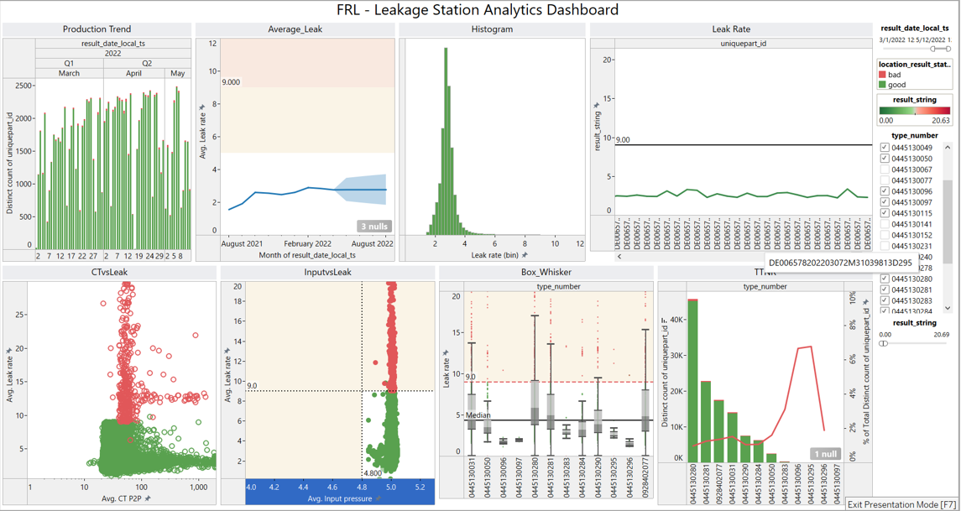
DaaS - Data as a Service | Overview
Data warehouse solution that enables self exploration and analysis of data at scale
Because each production area has individual needs and data structures, MAS makes the option available to access data captured with the MAS data pipeline
There is no need to build your own data warehouse; you can access the data already collected for MAS
Two Options to use Data as a Service
Use a custom data extract, in which the data is focused at a particular station. MAS processes the data; you create the visualization directly on the server
Connect directly to the Impala Tables via Tableau Desktop or PowerBI, in which you can create more complicated visualizations with relatively unprocessed data

Slide 13
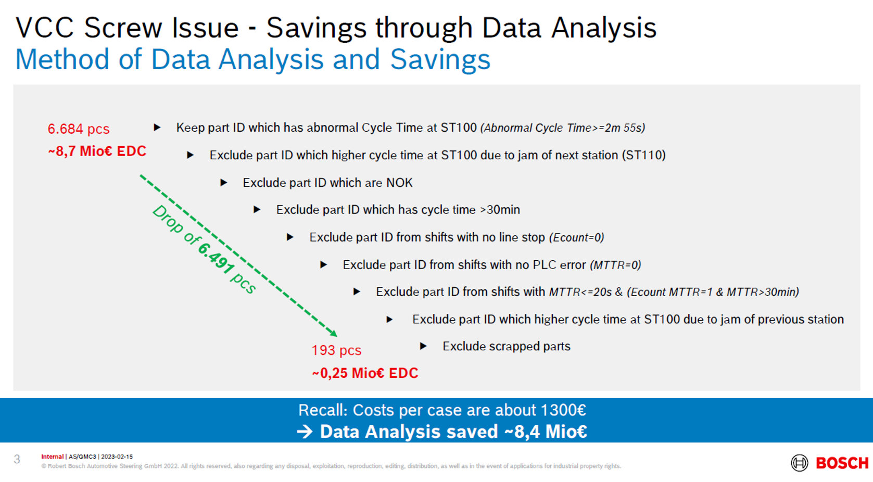
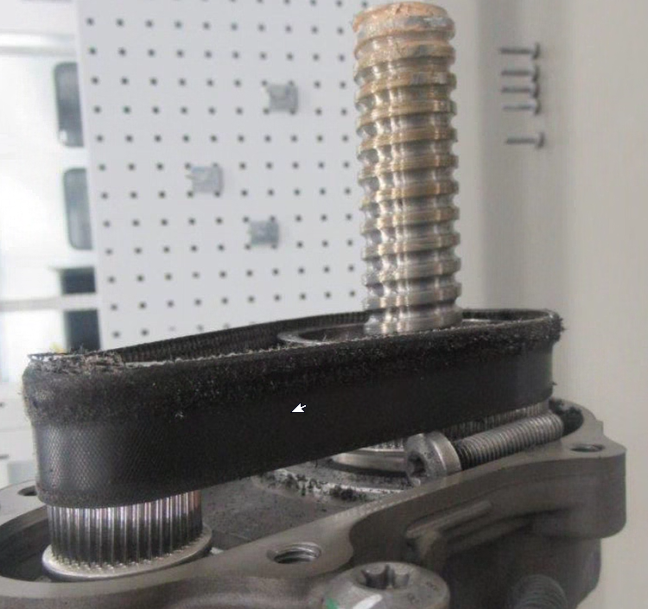
DaaS - Data as a Service | Use Case @ SgmP (AS)
Problem:
One Volvo SPA steering gear failed after 26.000 km in the field. A noise was coming from the gear and the steering function was blocked in the right direction
Root Cause:
The issue was caused by an extra screw in the KGT area due to an assembly error
Impact:
Saving ~8.4 Million Euro in recall cost

Slide 14
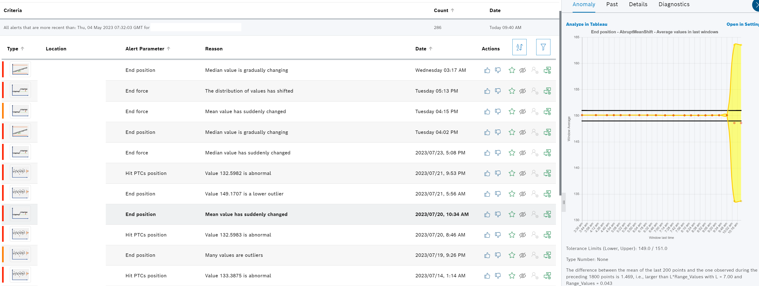
ADE - Anomaly Detection Engine | Overview
Real time detection and prediction of anomalies and adapting to user feedback
ADE uses AI and machine learning algorithms to monitor the production processes in real-time. ADE collects the data from MES (production line) and analyzes it using advanced statistical techniques to identify any anomalies or deviations.
Once the anomaly is detected, ADE automatically notifies the relevant users, allowing them to take immediate action. This could involve stopping the production line, making adjustments to the process or carrying out maintenance work.

Slide 15
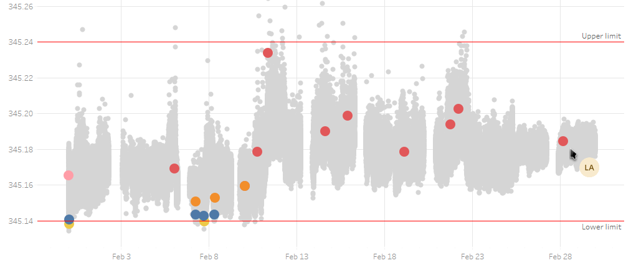
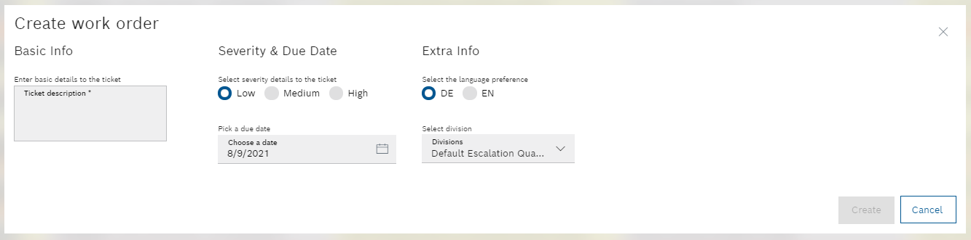




ADE - Anomaly Detection Engine | Use Case @ BaP (PS)
1
Reaction in 2h
7.000€/Y
PPM
TEF
2
3

Slide 16
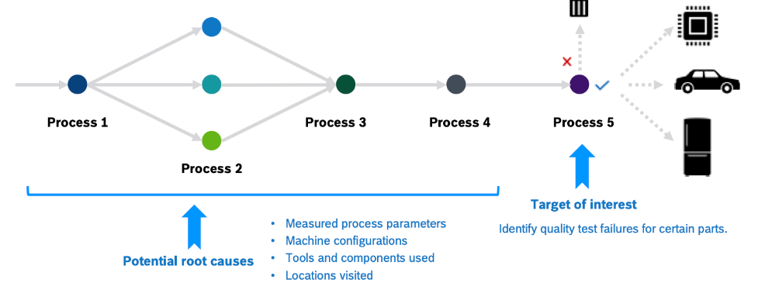
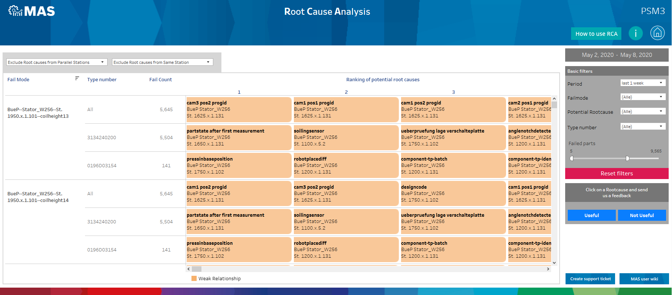
RCA - Root Cause Analysis | Overview
The goal of Root Cause Analysis (RCA) is to recommend the most likely root causes of different failure modes on Bosch assembly lines
Model and statistical methods used:
Seamlessly works with data available in MAS
Automatically provides potential root causes for failures modes and tests
Built big data infrastructure allows continuous application of large volume, large scale statistical tests not possible with standard tools
User Feedback
User can provide positive or negative feedback to root causes
Use user feedback is used to improve root cause analysis in supervised fashion

Slide 17
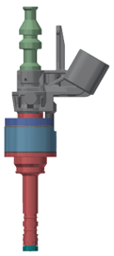
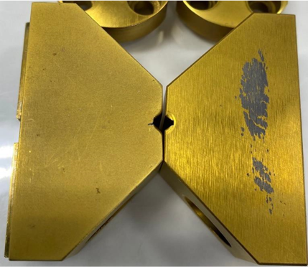
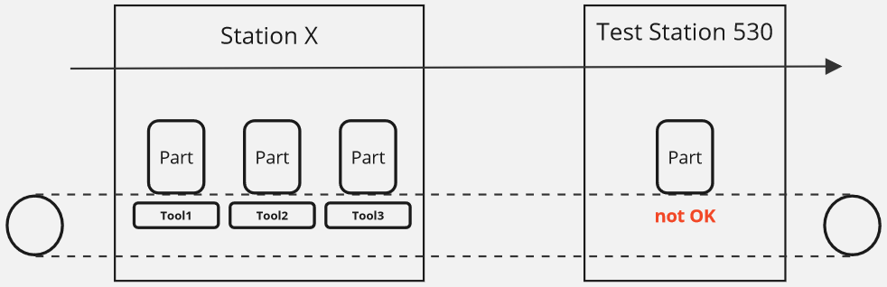
RCA - Root Cause Analysis | Use Case @ ChP (PS)
Problem:
HDEV6 Station 530 Qdyn/CVO test has abnormally high fallout for KS2.0 rating at start of 2021 production (>2% on 768 type)​
Sustained high press force issues for needle stop ring were observed during period of high KS2.0 fallout, correlation was investigated​
Root Cause:
„Keyhole“ notch in a new tool is worn away, this is used to align the needle, indent in top surface for stop ring tolerance is not there either
Impact:
>104T$/year​
HDEV6

Slide 18
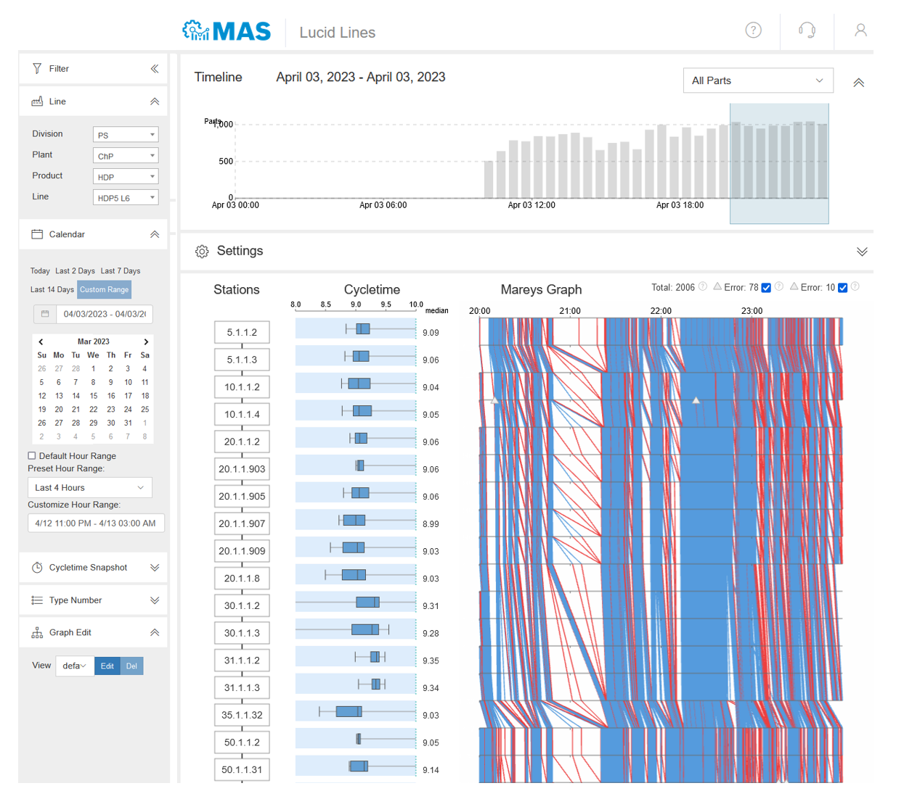
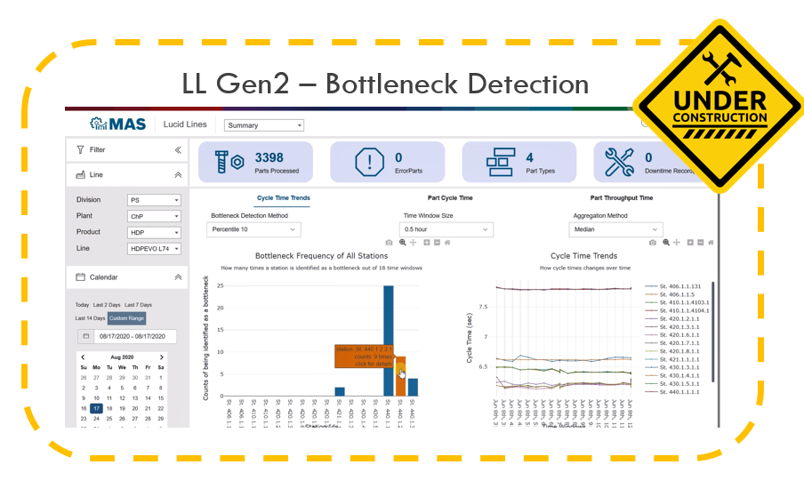
LL – LucidLines | Overview
LucidLines is a highly interactive cycle time application which provides big data visualizations of cycle time data at station and line level
The application includes visual elements such as a Marey´s graph, boxplots or graphical representations of the distribution of cycle time values for each station
As all information is provided on one screen, the application helps quickly spot bottlenecks, triggering actions to reduce cycle times and overall improve efficiency in production.

Slide 19
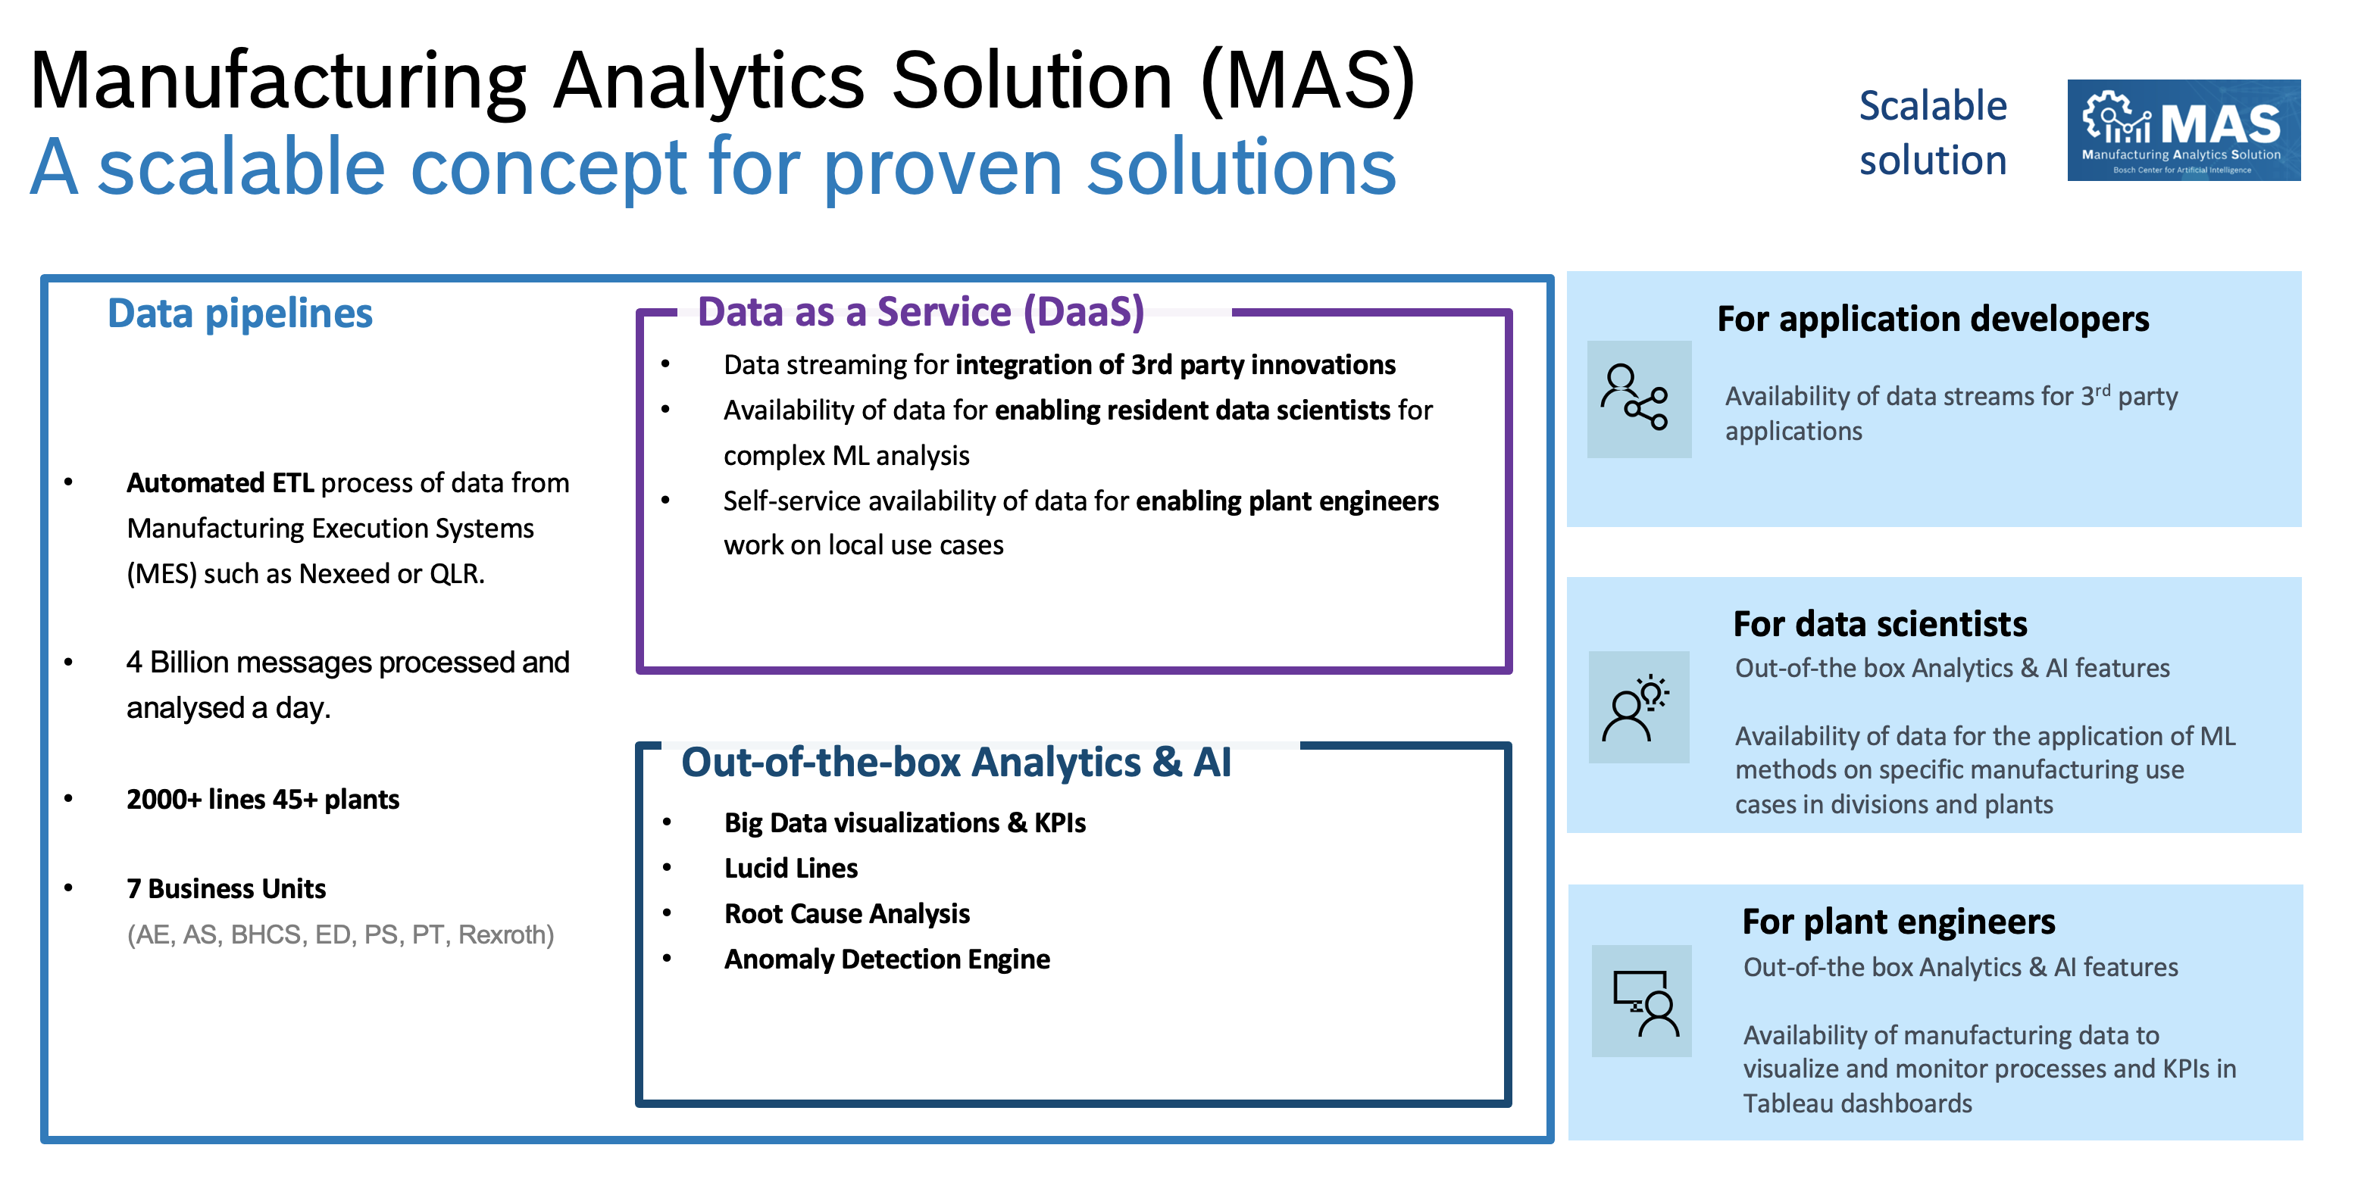
MAS (Manufacturing Analytics Solution)
Context
Goal
Data
MAS aims to provide users easy access to manufacturing data at as well as a suite of complementary analytics solutions that aid the user by automatically detecting manufacturing related inefficiencies and providing insights to help improve the efficiency in manufacturing domain.
MAS provides
A highly automated 'Generalized Data Lakehouse' solution for structured and unstructured data for Manufacturing.
A suite of scalable self-service AutoML and analytics tools that are optimized for manufacturing.
Generic
Modular
Manufacturing Plants
Impact
> 20Mi € of reported savings till 2022 at PS
8 BUs 90 IPNs 50 Plants 2000 Lines
Current year activity
Unified MAS interface
Integration with BMLP
Transfer of maintenance and Operations
Add Additional ML Innovation
Cycle Time monitoring
Bottleneck Detector
Value Stream mapping
Past year activity
Cloud readiness
Scale up ADE
Operational monitoring and stability
Ideation workshop in NuP1. 108+ ideas
Multiple POCs: lucid lines, RCA multivariate

